Slide 1

Unified Path Following Guidance for Hybrid VTOLs
Junwoo Hwang
Jaeyoung Lim, Florian Achermann, David Rohr, Thomas Stastny, Roland Siegwart, Hwangnam Kim
Bachelor Thesis
Autonomous Systems Lab, ETH Zurich

Slide 2
Motivation

Slide 3

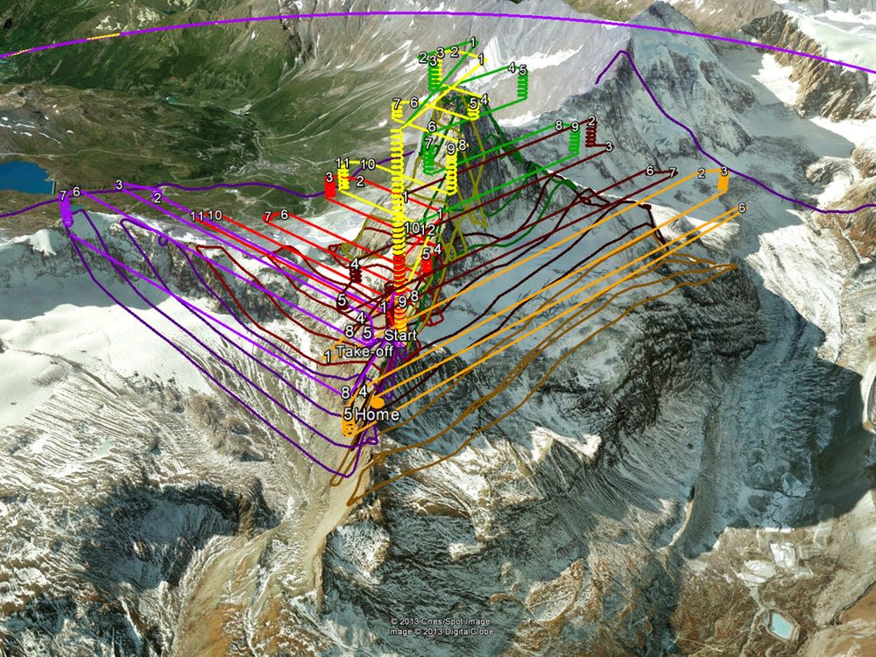
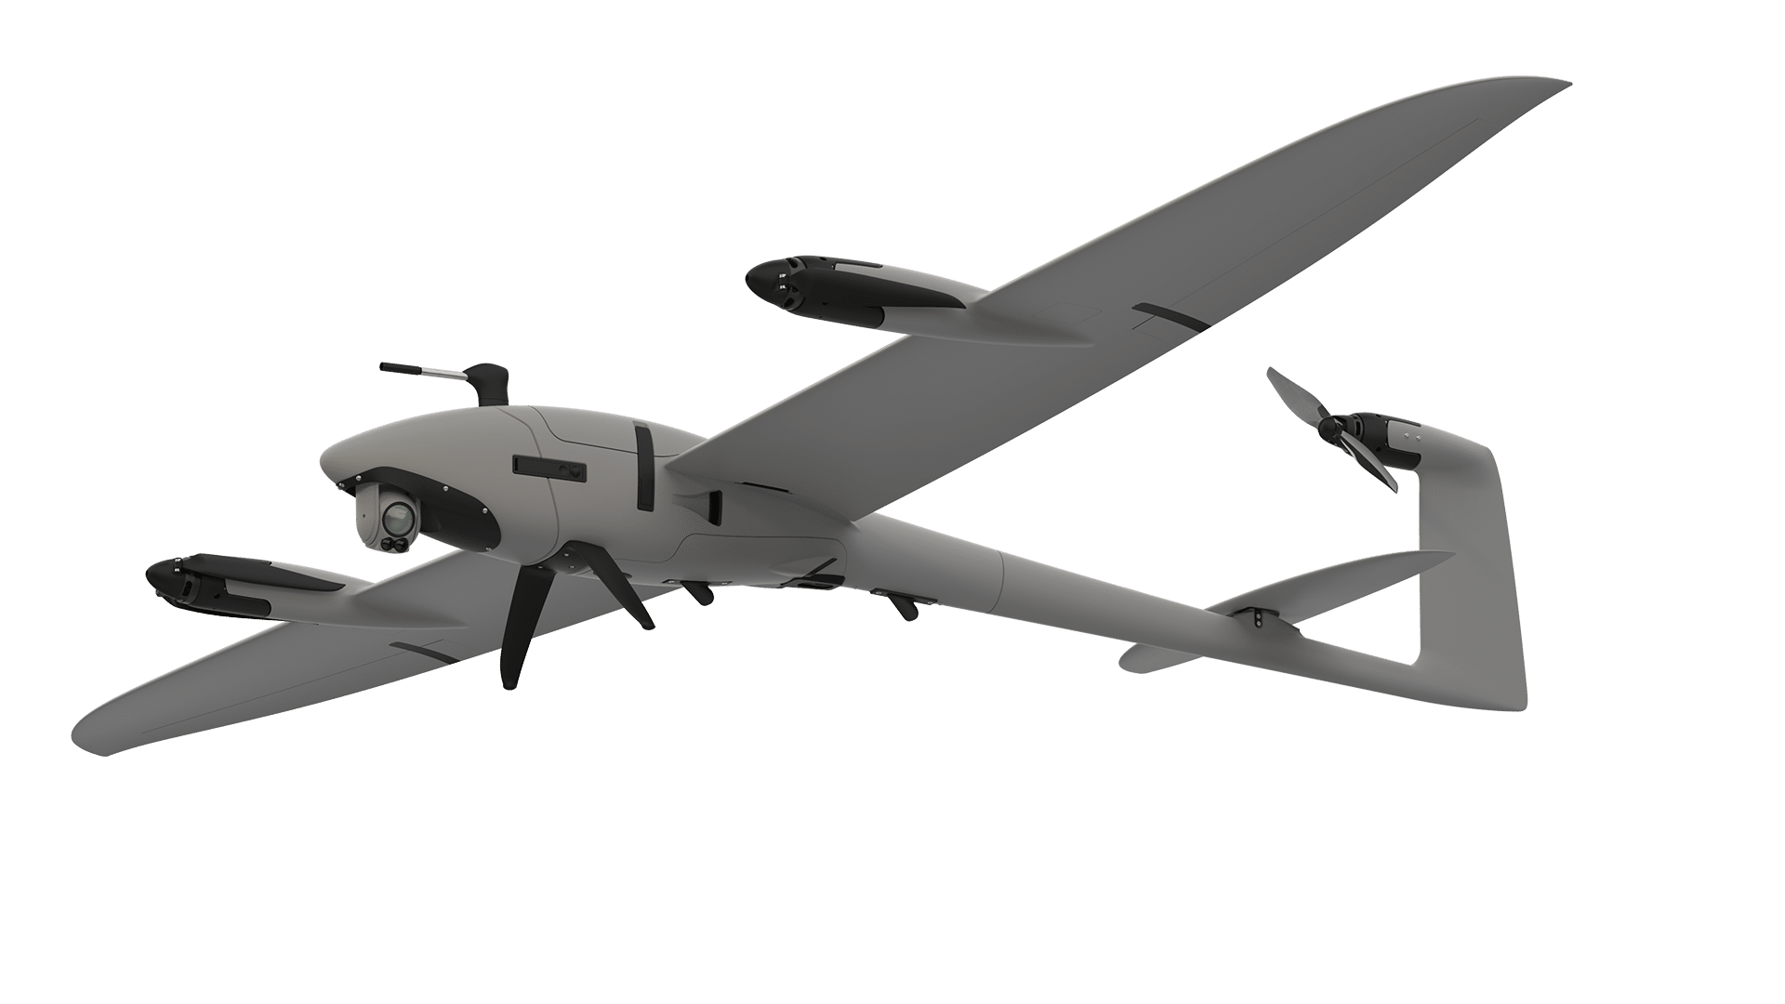
Motivation

Slide 4
Related Work

Slide 5
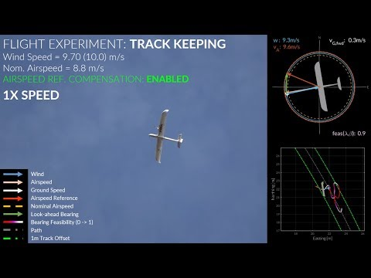
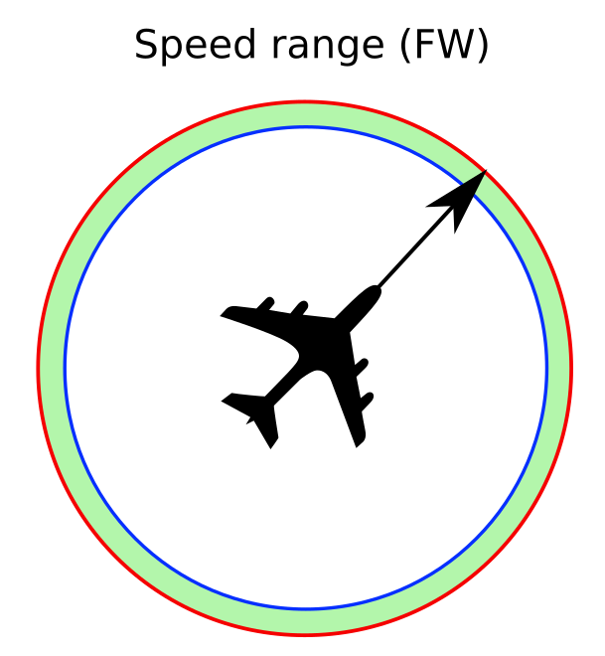
Related Work: Path Following on Fixed Wing
Nonlinear Control [Stastny, IROS, 2019]
T. Stastny. “On Flying Backwards: Preventing Runaway of Small, Low-speed, Fixed-wing UAVs in Strong Winds”. IROS, 2019

Slide 6
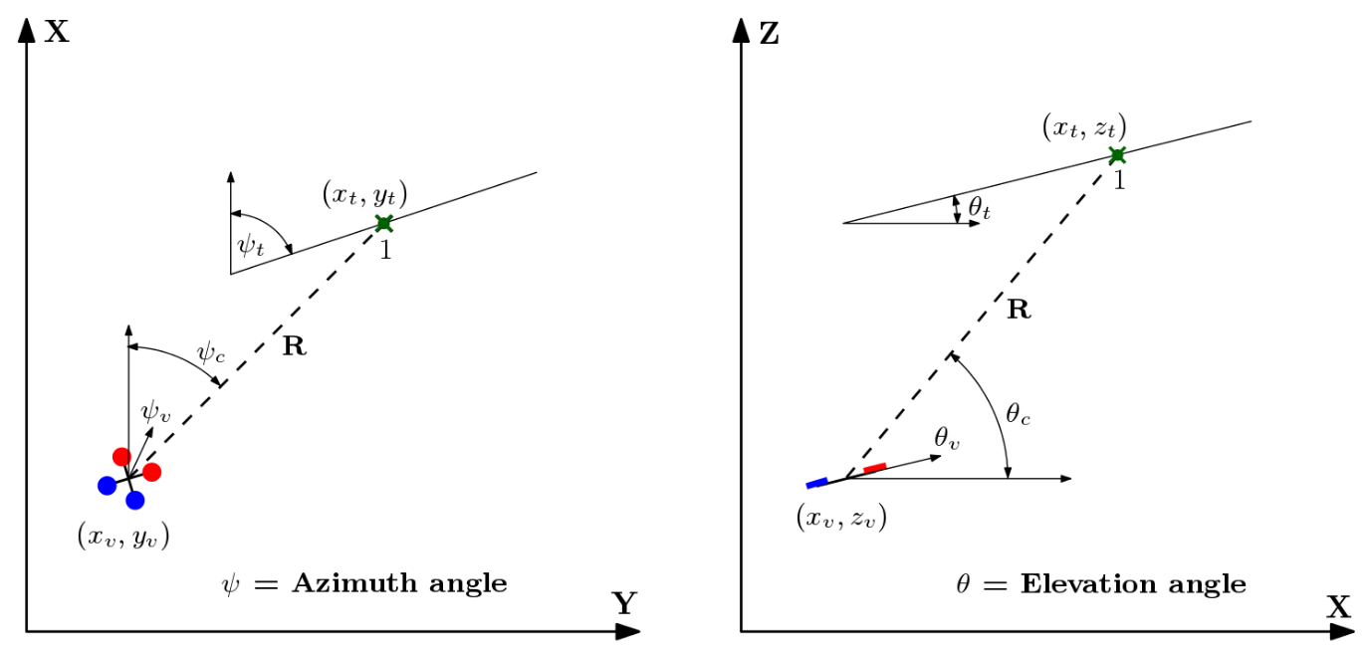
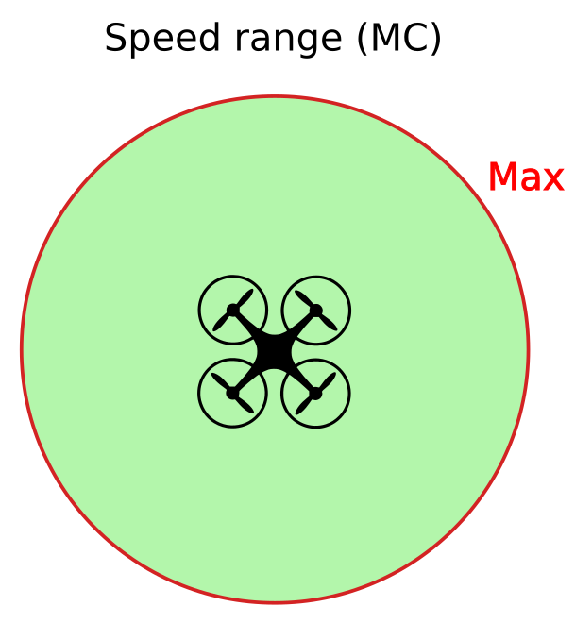
Related Work: Path Following on Multirotor
Virtual Target Pursuit [Manjunath, 2016]
Manjunath, A. R.. “Path following by a quadrotor using virtual target pursuit guidance.” (2016).

Slide 7
Problem Definition

Slide 8
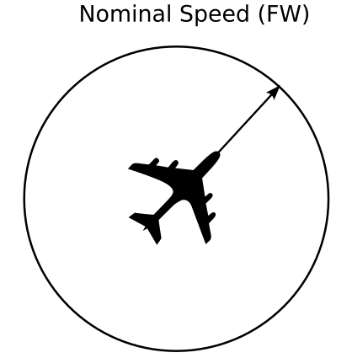
Limitation of conventional Fixed Wing Path Following
Fixed Wing flies at a constant ‘Nominal speed’

Slide 9

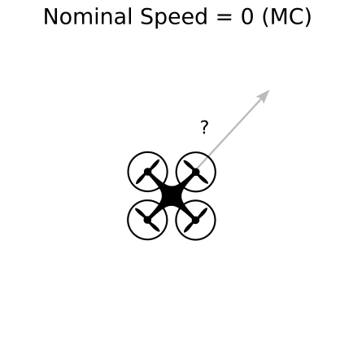
Limitation of conventional Fixed Wing Path Following
Fixed Wing flies at a constant ‘Nominal speed’
Multirotors can have a huge speed range, including ‘stopping’.
Using FW guidance on MC results in unintended approach path that isn’t meant for the ground velocity profile

Slide 10
Goal
“Unified Path Following Guidance that can be used by Fixed Wing, Multirotor, and Hybrid VTOL utilizing their full maneuverability envelope”

Slide 11
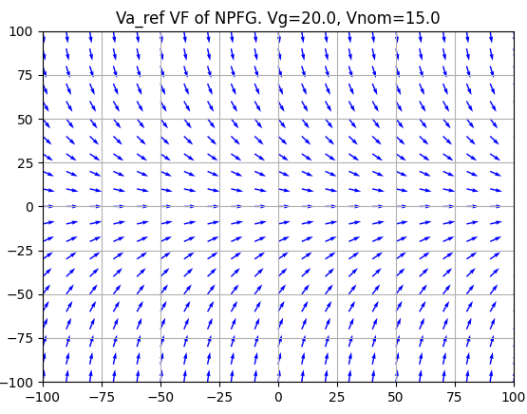
Approach
Vector Field Method
If vector is followed, converges to path
Desired course setpoint is generated
Geometric: more generic
Can be followed by any vehicle type!
Other methods: Optimal control, etc.

Slide 12

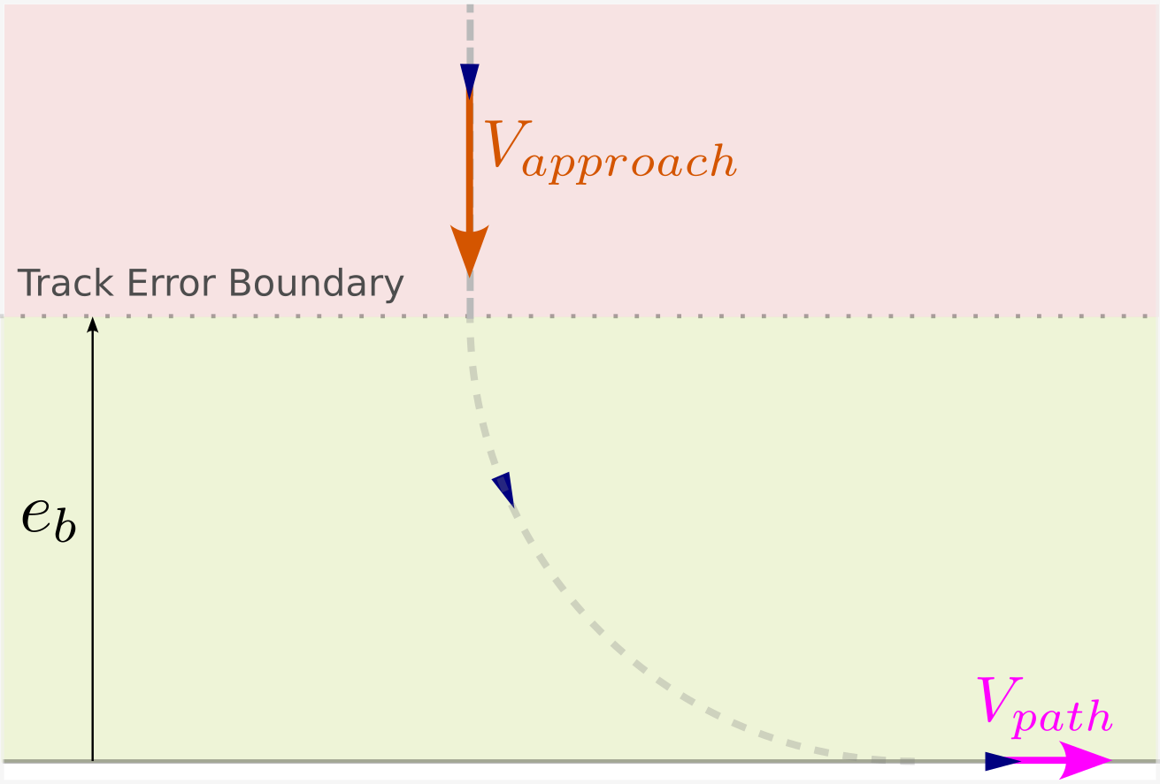
Approach: Overview

Slide 13
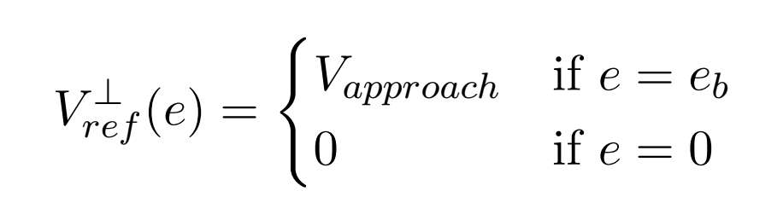
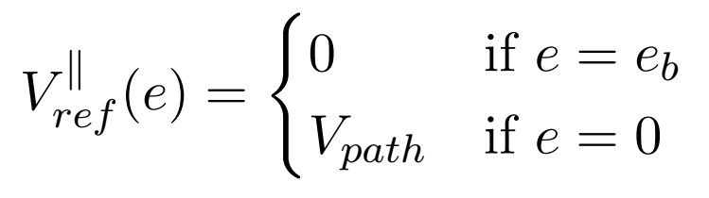
Approach: Problem Definition

Slide 14
Methods

Slide 15
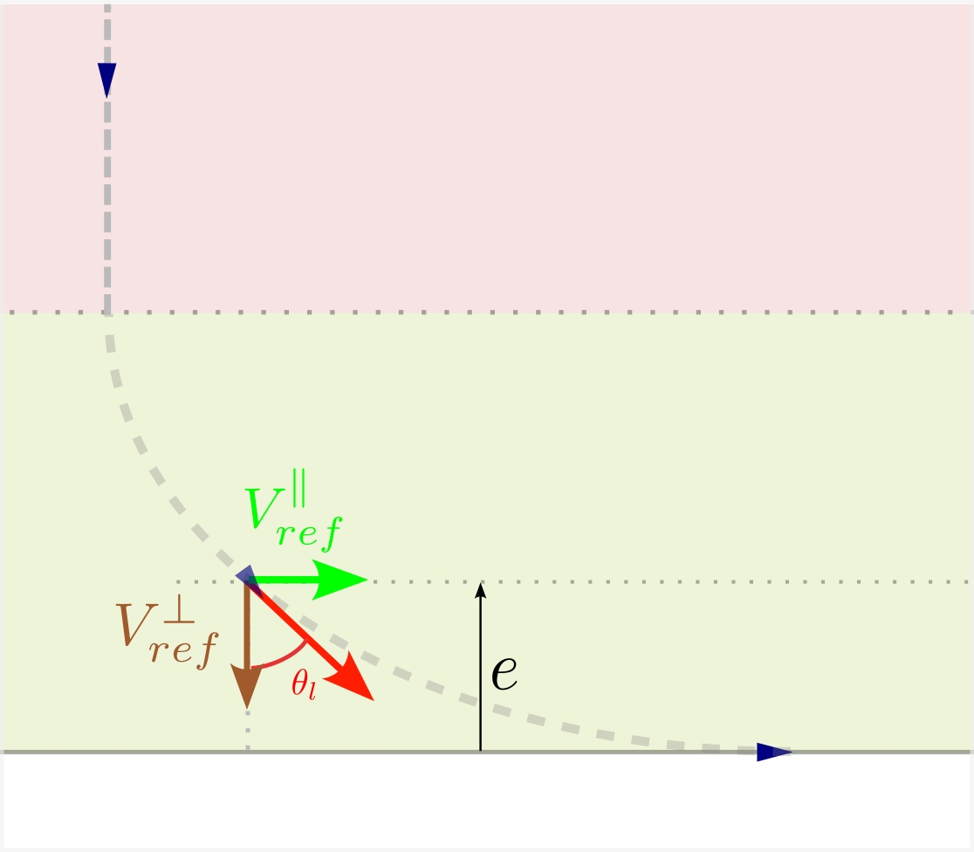
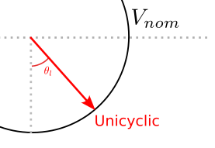
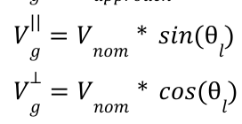
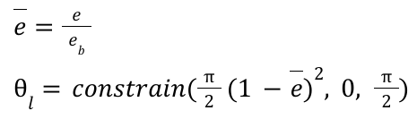
Methods
Unicyclic (Original)

Slide 16
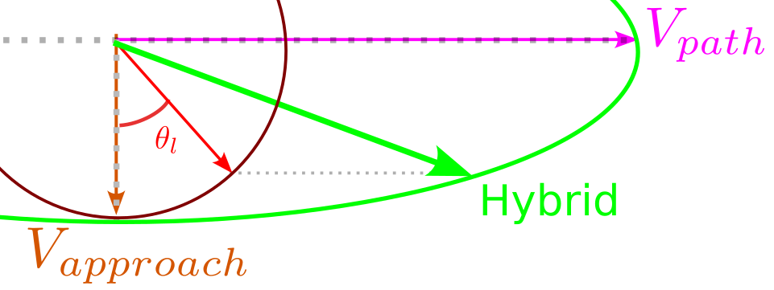
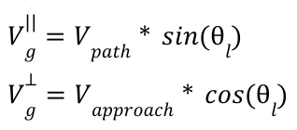
Methods
Unicyclic (Original)
Hybrid (Proposed)

Slide 17
Evaluation

Slide 18
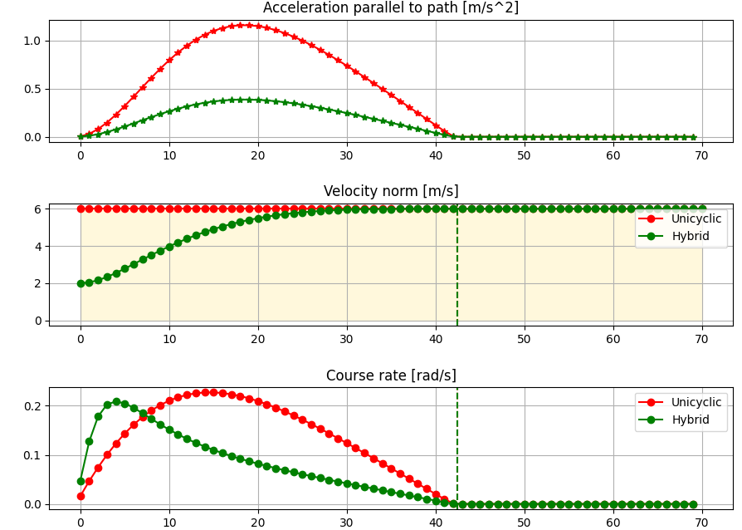
Evaluation Criteria
Approach speed: Does it approach at required speed?
Path speed: Does it reach the speed on path?
Monotonicity: Monotonic ground speed profile
Acceleration: Doesn’t exceed vehicle’s limit
Course rate: Doesn’t exceed vehicle’s yaw rate limit (FW)

Slide 19
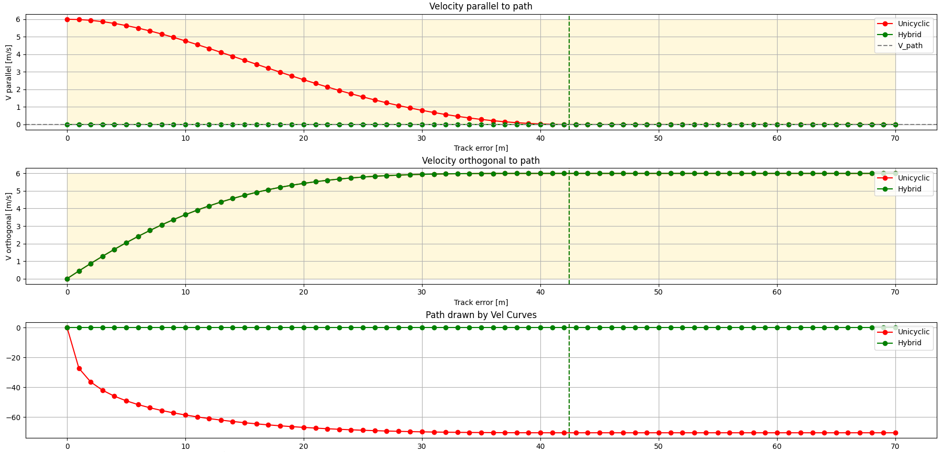
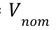
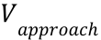
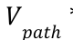
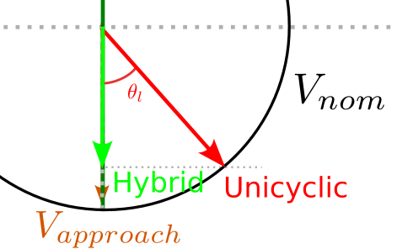
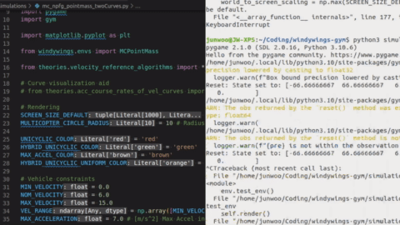
Evaluation: Zero speed on path
Parameter | Value
 | 6
 | 6
 | 0

Slide 20
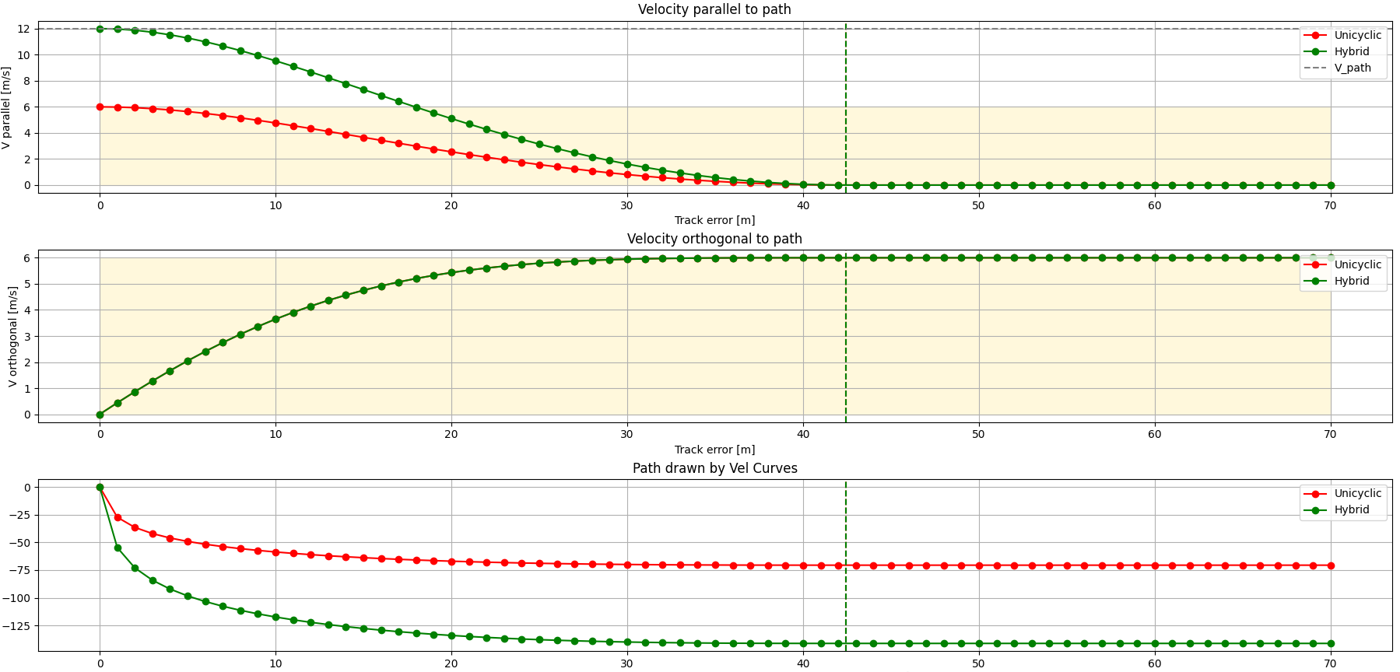
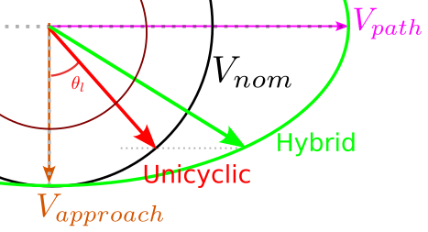

Evaluation: High speed on path
Parameter | Value
 | 6
 | 6
 | 12

Slide 21
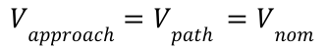
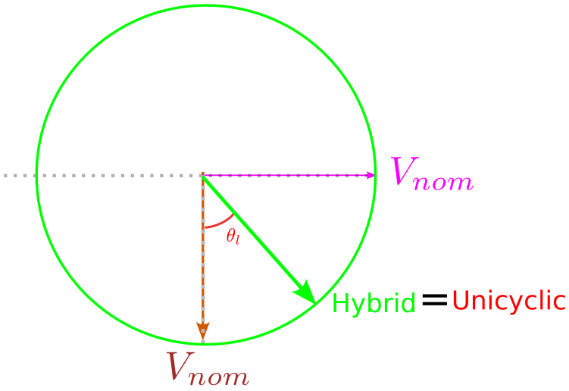
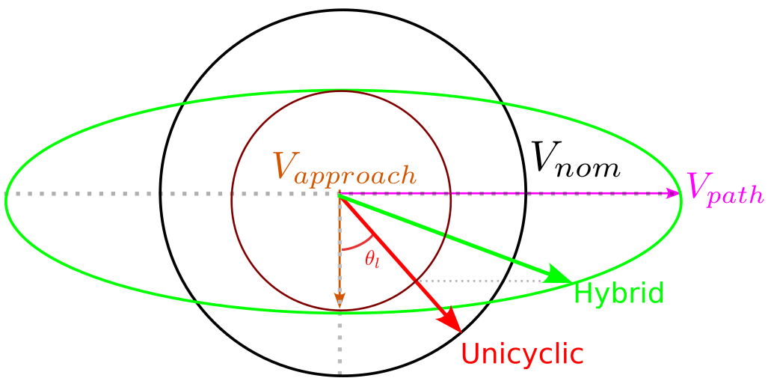
Evaluation: Is the FW case still supported?
Fixed Wing (Unicyclic) is just a special case where:
Hybrid

Slide 22

Result: Simulation
Unicyclic: 10 m/s nominal speed
Hybrid: 10 m/s approach & 7 m/s path speed

Slide 23
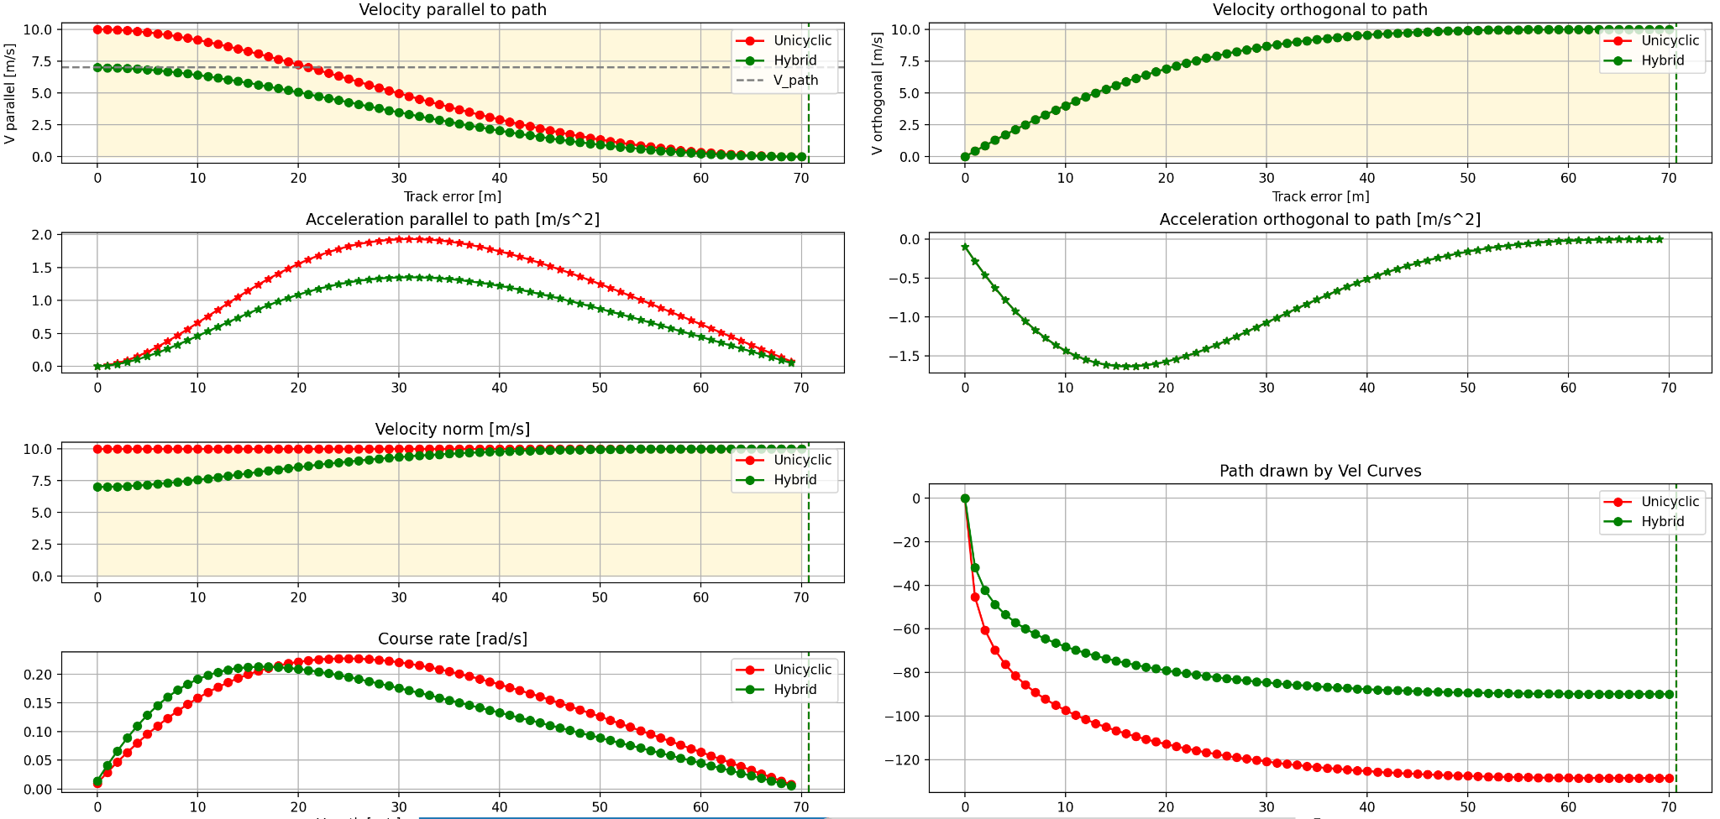
Result: Simulation
Fixed Wing: 10 m/s nominal speed
Multirotor: 10 m/s approach & 7 m/s path speed
Monotonicity: Guaranteed (Ellipsoidal velocity)
Acceleration limit is within Fixed wing’s limit (feasible for MC)

Slide 24
Discussion and Outlook
Achievements 🎉
Unified Path Following formulation applicable to both multirotor and fixed wing
Limitations 🙈
Dynamic constraints hasn’t been considered (Acceleration / Jerk)
Future Work 💪
Implementation & Testing on a real Hybrid VTOL
Incorporating wind into guidance (air velocity profile)

Slide 25
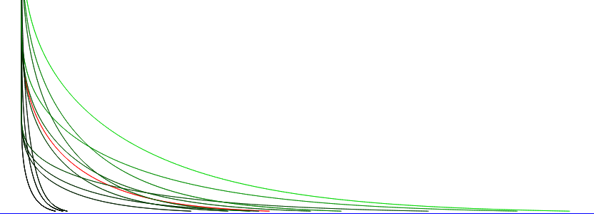
Thank you 🙌
Special thanks to: Jay, Florian, David, and Thomas

Slide 26
QnA Backup slides

Slide 27
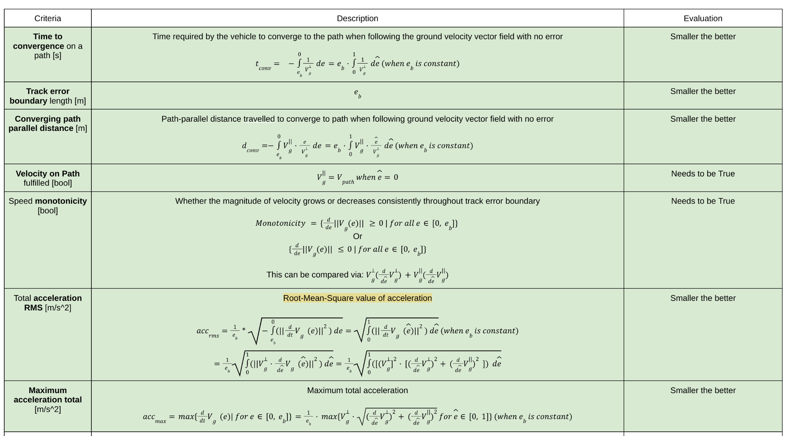
Path Following Evaluation Criteria

Slide 28
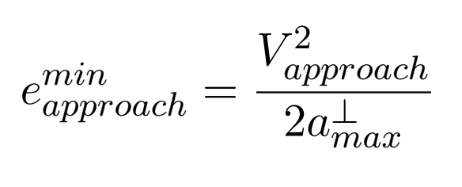
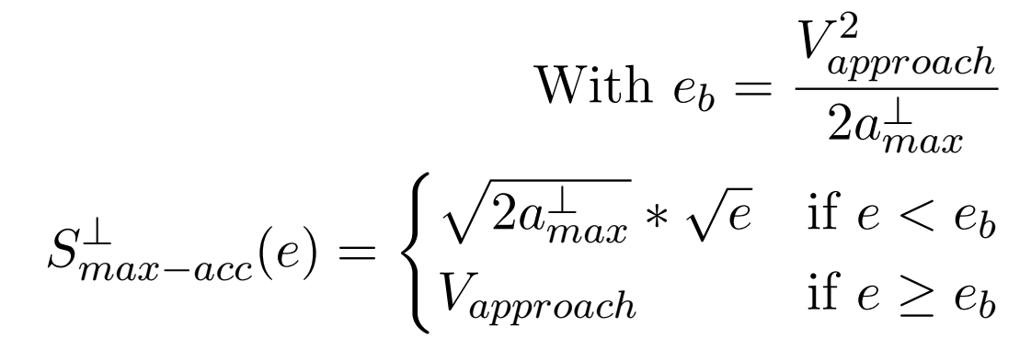
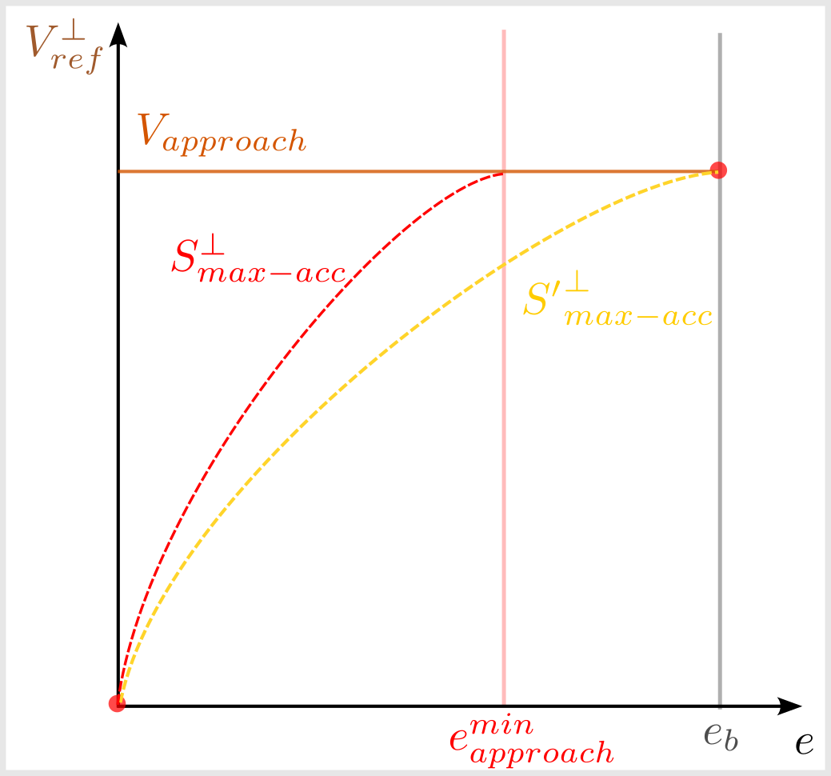
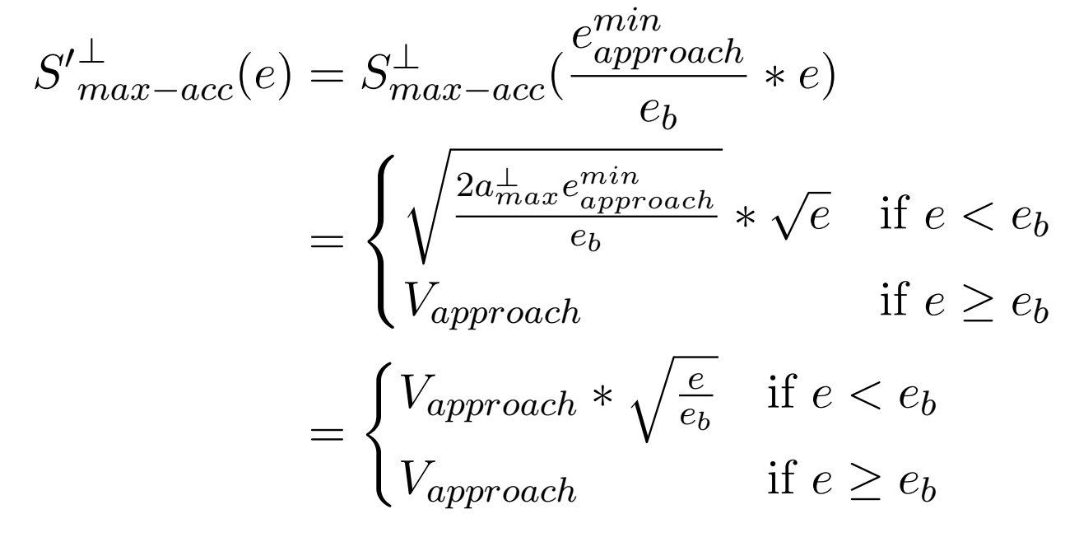
Maximum Acceleration Method: Orthogonal Velocity

Slide 29
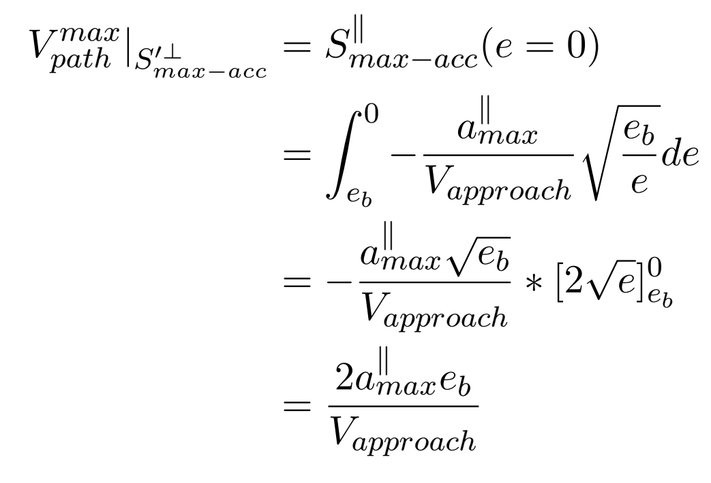
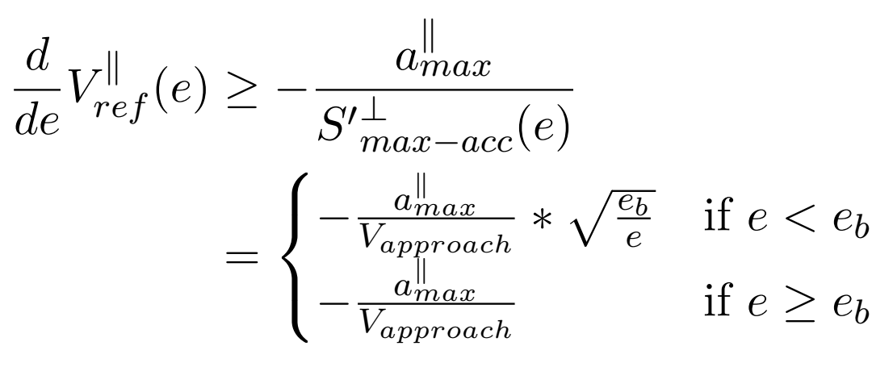
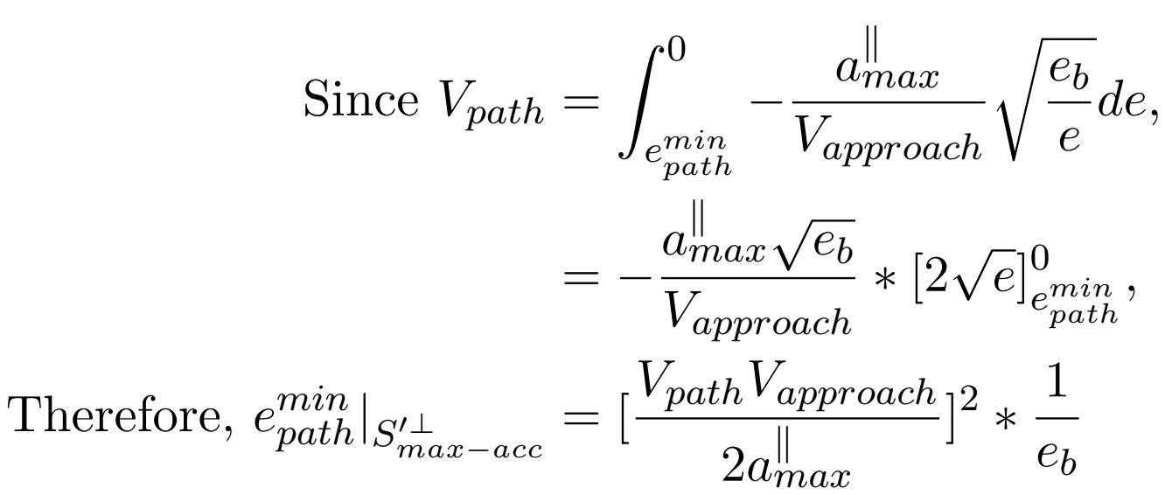
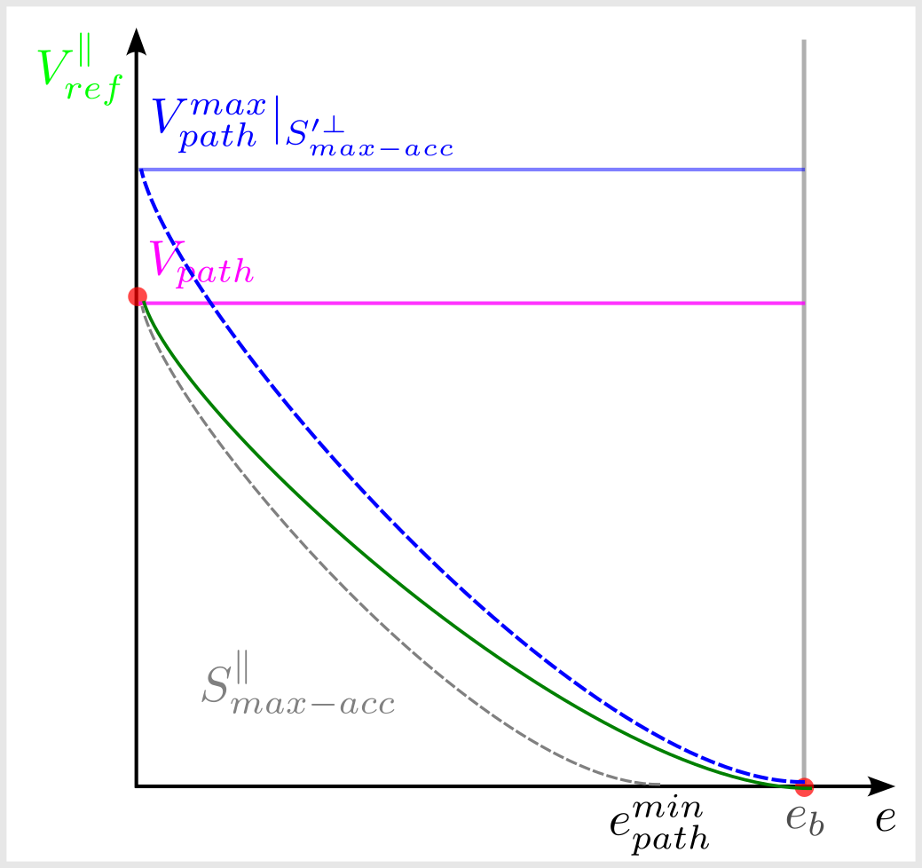
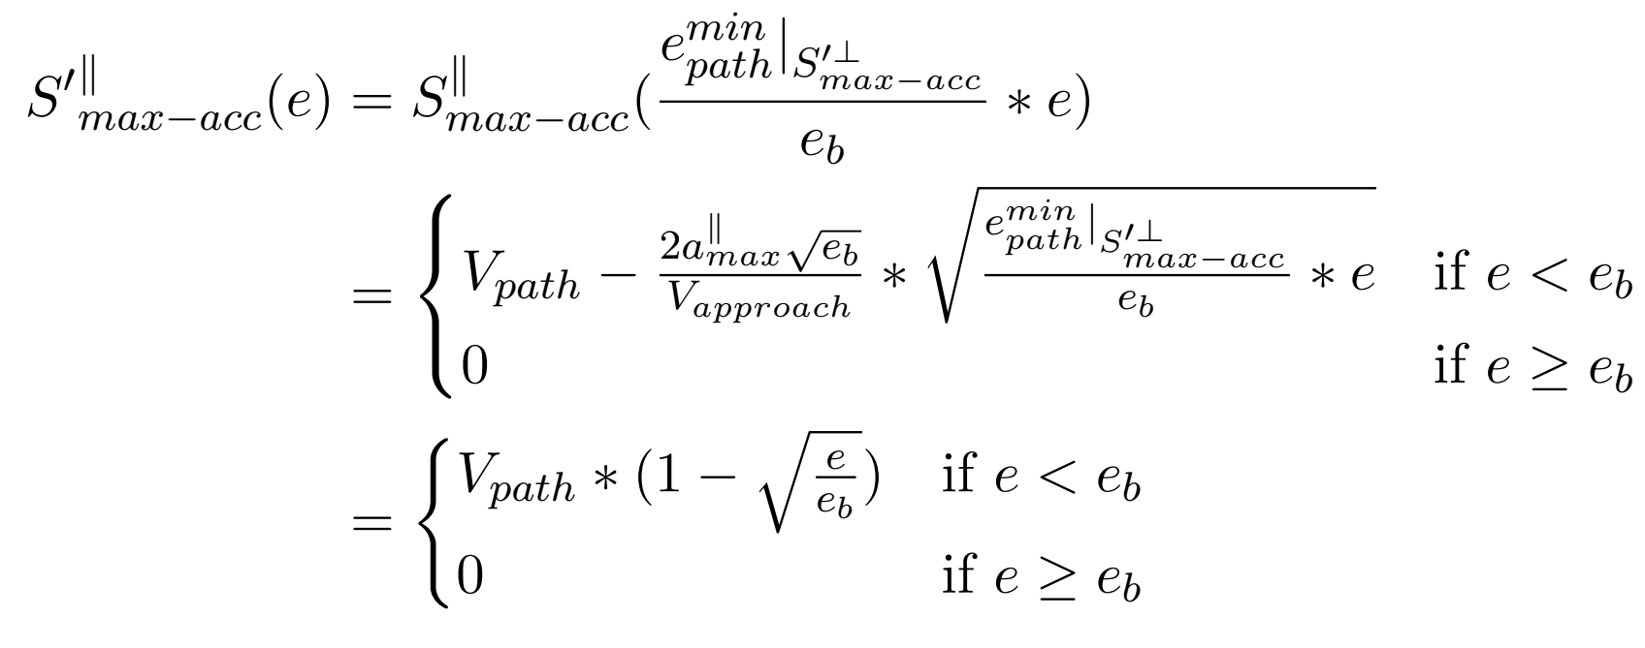
Maximum Acceleration Method: Parallel Velocity

Slide 30
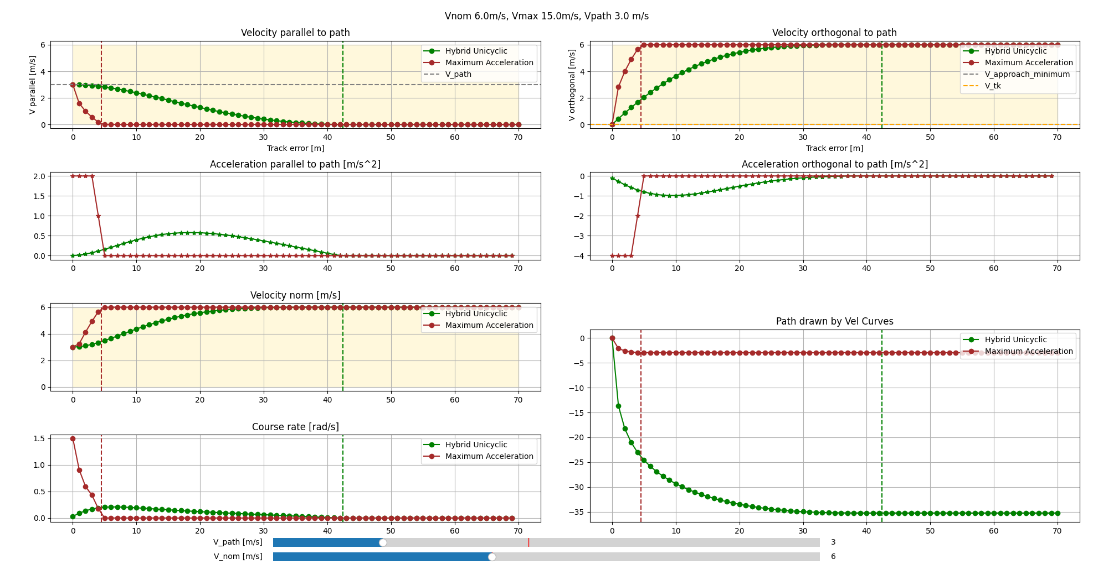
Maximum Acceleration method
Extremely small track error boundary

Slide 31
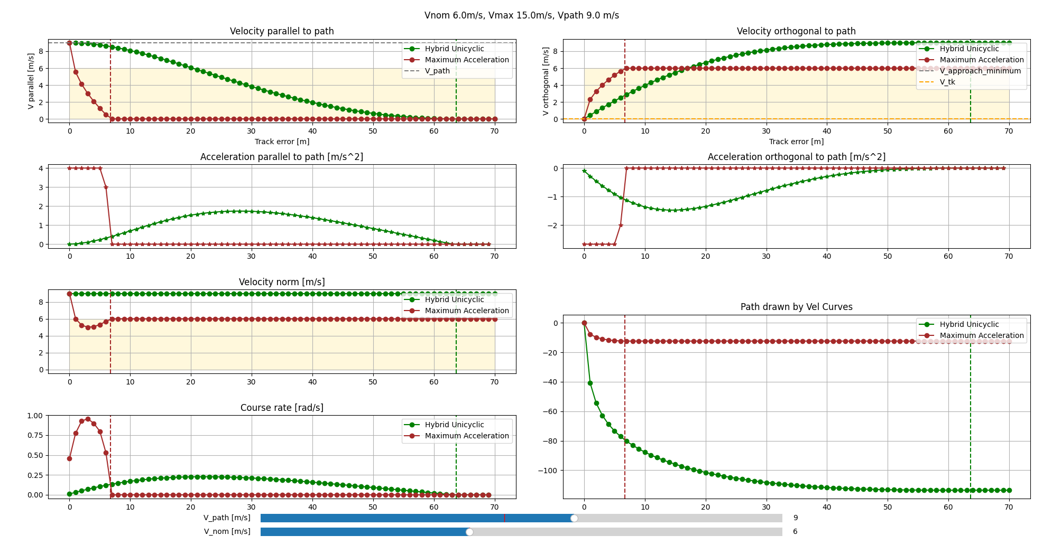
Maximum Acceleration method
Monotonicity not satisfied

Slide 32
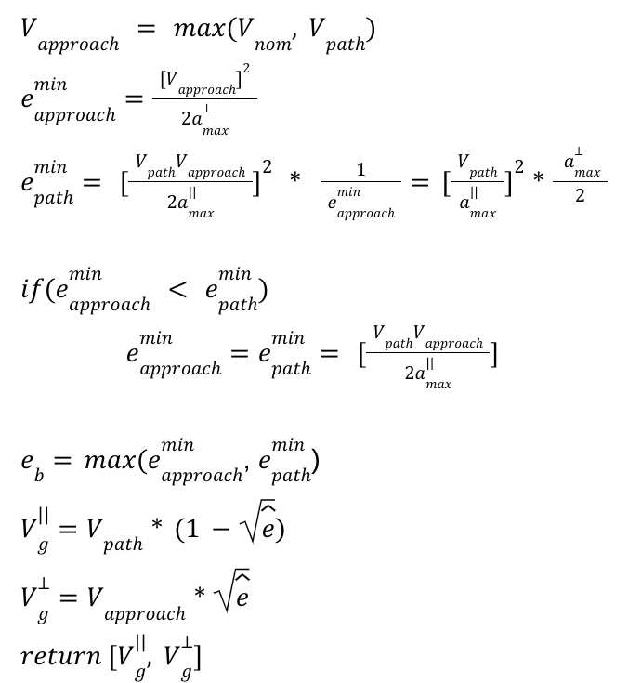
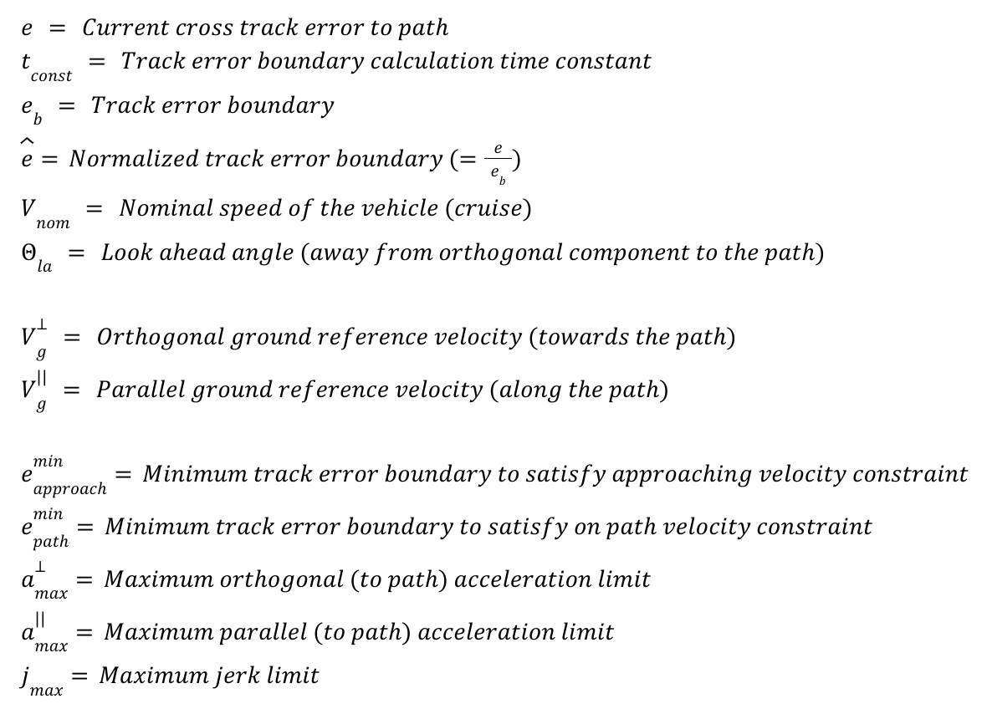
Maximum Acceleration Formulation

Slide 33
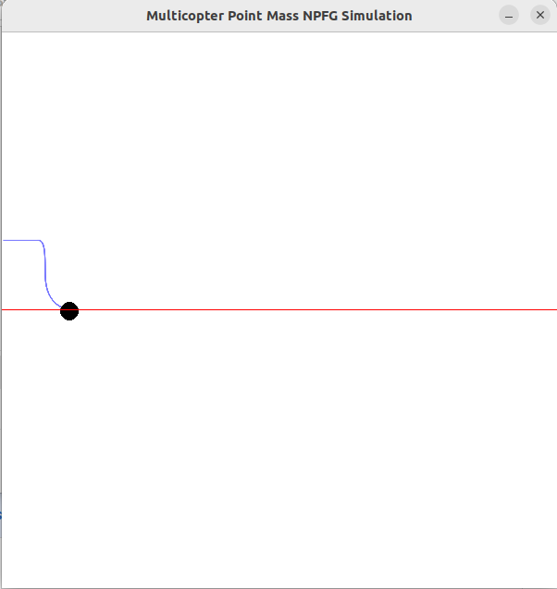
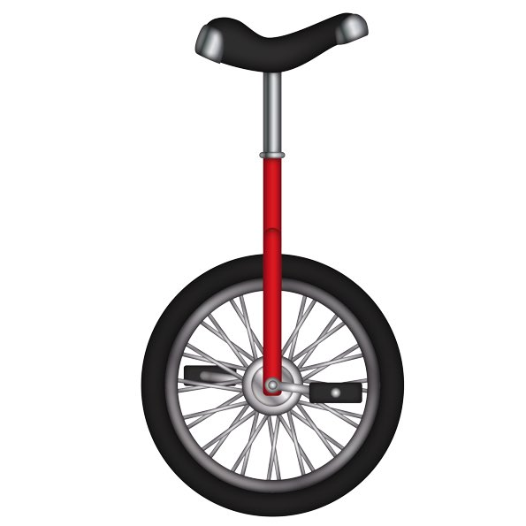
Limitation of the unicyclic path following algorithm
What do we do when we want to go slower on the path?
Unicyclic Path Following assumes that vehicle maintains the ‘nominal airspeed’, so it can never stop.
Reducing nominal airspeed produces weird artifacts
What about going faster?
We can set nominal airspeed to a higher value, but it alters the definition of ‘cruise speed’ (energy optimal speed)

Slide 34
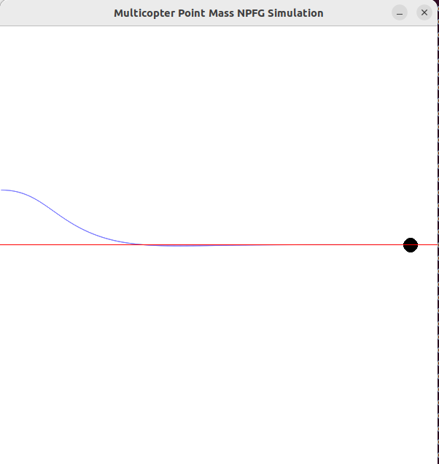
Track-keeping
User-set minimum ground speed = 5.0 m/s | User-set minimum ground speed = 0.0 m/s

Slide 35
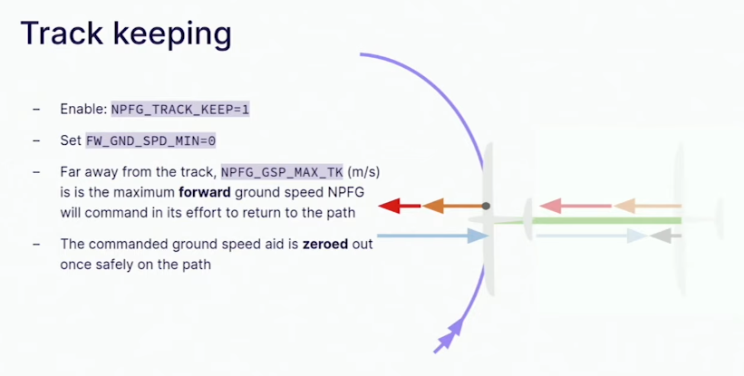
Limitations of NPFG Track-keeping feature

Slide 36

Limitations of NPFG Track-keeping feature

Slide 37
Bearing Feasibility
1 - feasibility
Minimum
Ground Speed
Track-Keeping
Minimum
Ground Speed
=
X

Slide 38

Bearing Feasibility
1 - feasibility
Minimum
Ground Speed
Track-Keeping
Minimum
Ground Speed
=
X

Slide 39
Bearing Feasibility

Slide 40
Bearing Feasibility

Slide 41
Bearing Feasibility

Slide 42
Bearing Feasibility

Slide 43

Multicopter vs Fixed-wing dynamics

Slide 44
Appendix
Slides that I won’t be using

Slide 45



Slide 46

Constraints of Multirotor and Fixed Wing System
Acceleration (Body Frame)
Lateral
Longitudinal
Velocity
Variable
Acceleration
Lateral (Yaw coupled)
Longitudinal
Velocity
Constant

Slide 47
Methods
Look ahead angle
Unicyclic
Hybrid Unicyclic

Slide 48
Path Following for Multirotor / Fixed Wing
Holonomic
Non Holonomic

Slide 49
Why do we need Unified Path Following?
Fixed Wing Path Following doesn’t work on Multirotor!

Slide 50


Base Method
Unicyclic Method [Stastny, IROS, 2019]

Slide 51


Proposed Method
Hybrid Unicyclic Method

Slide 52
Test Conditions
For evaluating the Ground Velocity curve:
No wind
Track error boundary is fixed (Only look-ahead angle & speed is varied)
Approach speed is fixed (To allow consistent entry for comparison)
Vehicle tracks ground velocity perfectly (first order system)

Slide 53


Limitations
Constant speed assumption for Multirotor (Limited maneuverability)
No generic Path Following Guidance that suits both modes of operation

Slide 54
Base Method
Unicyclic Method [Stastny, IROS, 2019]

Slide 55

Base Method

Slide 56
Proposed Method
Hybrid Unicyclic Method

Slide 57

Proposed Method: Low speed on Path (Aggressive turning)

Slide 58

Proposed Method: High speed on Path (Smoother turning)

Slide 59


Path Following for VTOL: Current Status
Decoupled between MC / FW
https://docs.px4.io/main/en/flight_stack/controller_diagrams.html

Slide 60

What is Path Following?

Slide 61

What is a Hybrid VTOL?

Slide 62
Modes of operation of Hybrid VTOL

Slide 63
Modes of operation of Hybrid VTOL
Fixed Wing
Multirotor

Slide 64

Modes of operation of Hybrid VTOL
Fixed Wing

Slide 65
Modes of operation of Hybrid VTOL
Acceleration
Lateral (Rolling): Coupled with yaw
Longitudinal: (almost) None
Vertical (Pitching): Flexible
Velocity
Airspeed: (almost) Constant
Fixed Wing

Slide 66

Modes of operation of Hybrid VTOL
Multirotor

Slide 67
Modes of operation of Hybrid VTOL
Acceleration
Lateral (Rolling): Full range
Longitudinal (Pitching): Full range
Vertical (Throttle): (almost) Full range
Velocity
Airspeed: Full range
Multirotor

Slide 68

Related Work: Path Following on Fixed Wing
Nonlinear Control [Stastny, IROS, 2019]
Line of Sight Control [Curry, ACC, 2013]
T. Stastny. “On Flying Backwards: Preventing Runaway of Small, Low-speed, Fixed-wing UAVs in Strong Winds”. IROS, 2019
R. Curry. "L+2, an improved line of sight guidance law for UAVs". American Control Conference, 2013

Slide 69

Related Work: Path Following on Multirotor
Virtual Target Pursuit [Manjunath, 2016]
Vector Field [Zhou, 2014]
Manjunath, A. R.. “Path following by a quadrotor using virtual target pursuit guidance.” (2016).
D. Zhou, "Vector field following for quadrotors using differential flatness," ICRA (2014)

Slide 70
Evaluation Criteria
Time to Convergence
Δt

Slide 71
Evaluation Criteria
Time to Convergence
Converging Path Parallel Distance

Slide 72
Evaluation Criteria
Time to Convergence
Converging Path Parallel Distance
Monotonicity of Ground Speed

Slide 73
Evaluation Criteria
Time to Convergence
Converging Path Parallel Travel
Monotonicity of Ground Speed
Total Acceleration RMS

Slide 74
What is Path Following?

Slide 75
What is Path Following?

Slide 76
What is Path Following?

Slide 77
What is Path Following?

Slide 78
Problem Definition: Revisited

Slide 79
Problem Definition: Revisited

Slide 80
Problem Definition: Revisited

Slide 81
Problem Definition: 3 Phase breakdown

Slide 82
Problem Definition: Approach phase

Slide 83
Problem Definition: Turning phase

Slide 84
Problem Definition: On path phase

Slide 85
Problem Definition: Re-defined
3 Phase sequence (Velocity profile, Track error boundary)

Slide 86
Problem Definition: Re-defined
3 Phase sequence (Velocity profile, Track error boundary)
Acceleration commands to guide the vehicle

Slide 87
Problem Definition: Re-defined
3 Phase sequence (Velocity profile, Track error boundary)
Acceleration commands to guide the vehicle
While respecting vehicle’s maneuverability

Slide 88

Problem Definition: Defining the Ground Velocity Curve
Look-ahead angle

Slide 89

Problem Definition: Defining the Ground Velocity Curve
Look-ahead angle
Path parallel / orthogonal velocity
Track error boundary

Slide 90
Evaluation
Conditions
Track error boundary: 70 m
Approach speed: 10 m/s
Speed on path: 15 m/s
Criteria | Unicyclic | Hybrid Unicyclic
Time to Converge | 12.5 seconds | 21.2 seconds
Converging path parallel travel | 82 m | 82 m
Ground speed monotonicity | True | True

Slide 91


Related Work: Path Following on Hybrid VTOL
INDI based Vector Field Path Following [Zhou, 2022]
Li, Zhou. “Incremental nonlinear dynamic inversion based path-following control for a hybrid quad-plane unmanned aerial vehicle” (2022)

Slide 92
References
https://www.pix4d.com/blog/modelling-matterhorn/
https://tenor.com/view/who-cares-meme-gif-24186451

